Slide 1
Weight of Trophy Largemouth Bass as a function of Catch Date, Lake Size,
Lake Age, and Drainage Area
Travis Killen
May 2009

Slide 2




Introduction
Largemouth Bass Fishing in East Texas
East Texas State Records
Lake Fork

Slide 3
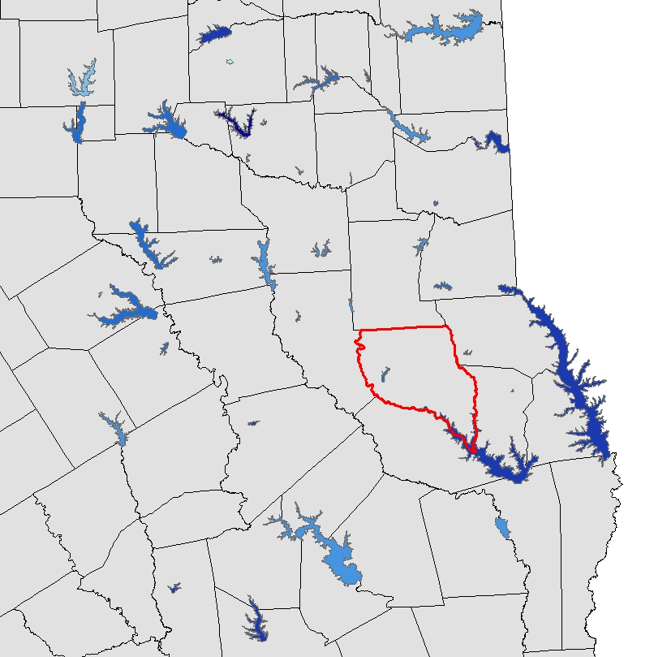
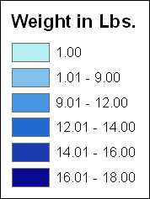
Study Area

Slide 4


Data Collection
Problems finding data…
State Record Info:
  Weight
  Length
  Catch Date
GIS Data:
  Lake Size
  Lake Age
  Drainage Area

Slide 5
Hypothesis
H₀ :
  Catch Date, Lake Size, Lake Age, Drainage Area cannot be used to determine weight of trophy largemouth bass.
H_{a} :
  At least one independent variable is significant in determining weight.

Slide 6
Preliminary Results

Slide 7
Preliminary Results

Slide 8
Preliminary Results

Slide 9
Preliminary Results

Slide 10
Linear Regression
R² = 0.215282
Do I have the right data?
Probably not!
F = 1.188819
1.19 < 2.47
Fail to Reject H₀
Overall significance of F
0.342961

Slide 11
Linear Regression
 | Coefficients | P-Value
Q1 | 1.255498 | 0.172431
Q2 | 2.460215 | 0.061268
Q3 | 2.951194 | 0.439645
Area (m2) | 2.88E-09 | 0.501253
Drainage Area | -0.00036 | 0.251117
Age | -0.02572 | 0.322093

Slide 12
Conclusions
Conclusions from my data?
Keep your line wet January - May
What data should be collected?
Water Temperature
Stocking Reports
Bait Used

Slide 13




Questions?

