Slide 1

Planning Outdoor WiFi Networks Using Mobile & Field GIS
By: Travis Killen
Date: May 28, 2008

Slide 2
Introduction
Outdoor Wireless Networking
Access Point
Interference
Notes:
Access Point:
Connects end user
Needs Power
Interference:
Buildings
Electro Magnetic
Home Networking

Slide 3
Applications
Who uses outdoor wireless networking?
State Parks
& Facilities
Schools
RV Parks
Notes:
Schools:
SFA Lawn
RV Parks
State Parks:
GIS Mapping & Internet Capability

Slide 4
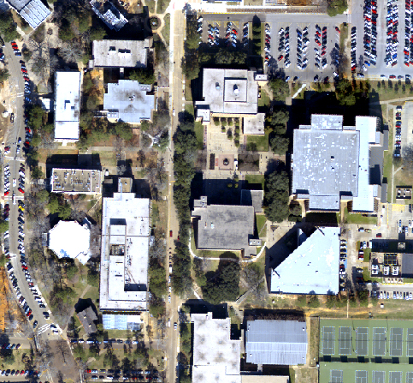
Preliminary Work
Gather Data
Satellite Imagery
Prospective Access Point Location (PAPL)
Existing Access Point Location (EAPL)
User Access
Interference
Notes:
Satellite Imagery
Prospective Access Point Location:
Lamps, telephone poles
Existing Access Point Location:
Building Side
User Access
Bench, Table, Field, Road
Interference

Slide 5
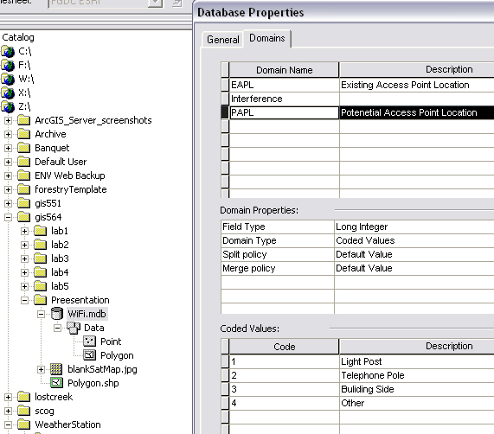
Preliminary Work
Build Geo-database
Identify types
Identify subtypes
Notes:
Build Geodatebase
Identify types:
Potential Access Point, Interference, User Access, Existing Access Point Location
Identify Subtypes
Light post, Telephone pole, Building side, other

Slide 6
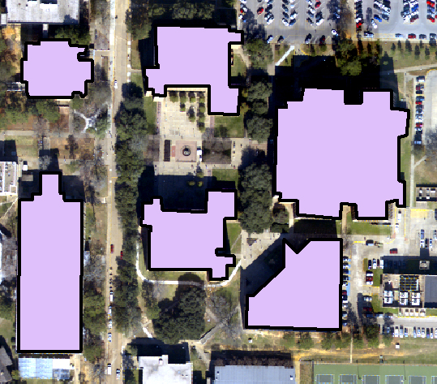
Preliminary Work
Identify known points of interference
Notes:
Edit Polygon Feature Data Class – Show interference

Slide 7
Preliminary Work
Prepare your equipment
Check Out Data to ArcPad
Charge Batteries

Slide 8
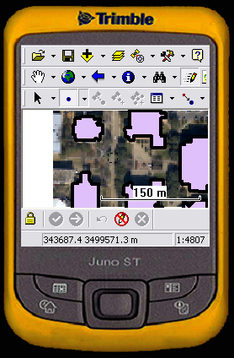
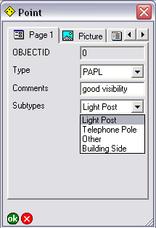
Field Work
GPS Point Data

Slide 9
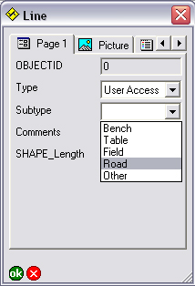
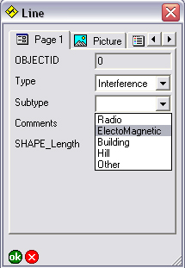
Field Work
GPS Line Features
Notes:
User access line - road
Interference – Electric Lines

Slide 10
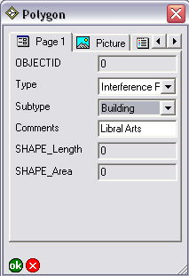
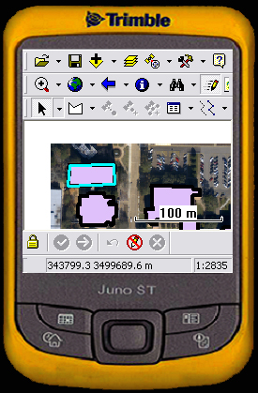
Field Work
GPS Polygon Features
Notes:
Polygons show up in the field

Slide 11

Post-Processing
Differential Correction
Modify Features

Slide 12
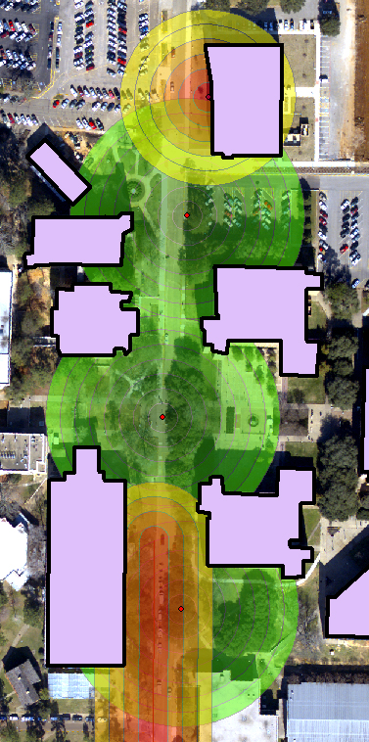
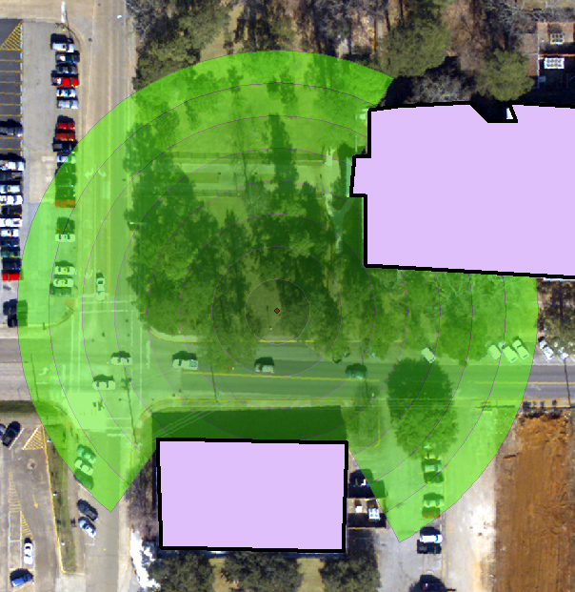
Tools & Models
Multi-Ring Buffer
Visibility
Notes:
Interference:
Close to Red – Less signal
Visibility:
Buildings can block signal behind them

Slide 13
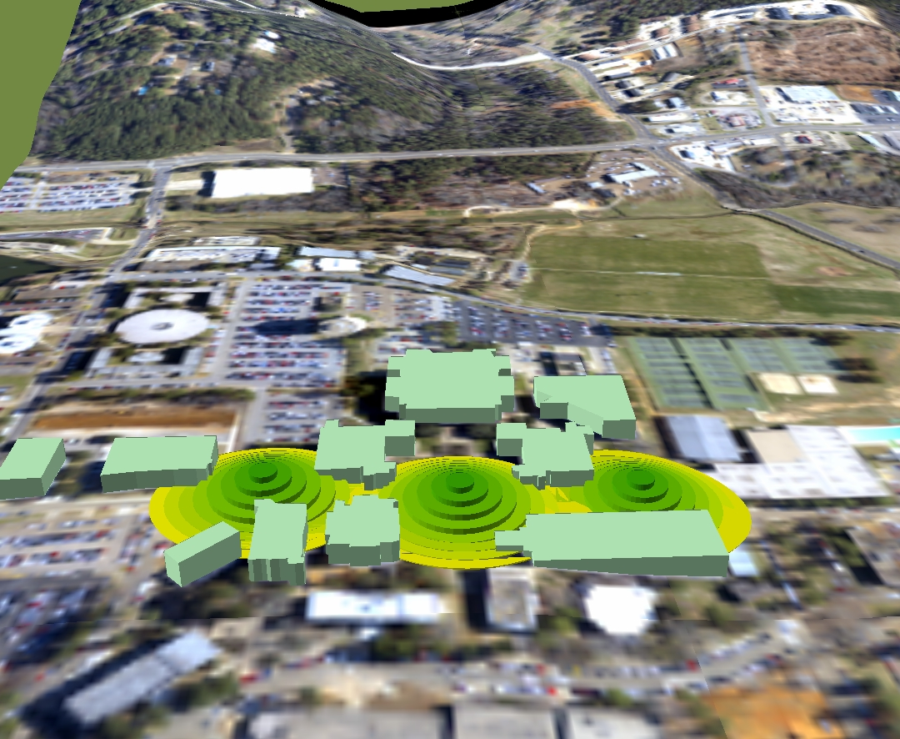
3D Possibilities
Using ArcScene
Notes:
3d Model – DEM
Extrude Buildings
Extrude Access Point Locations

Slide 14
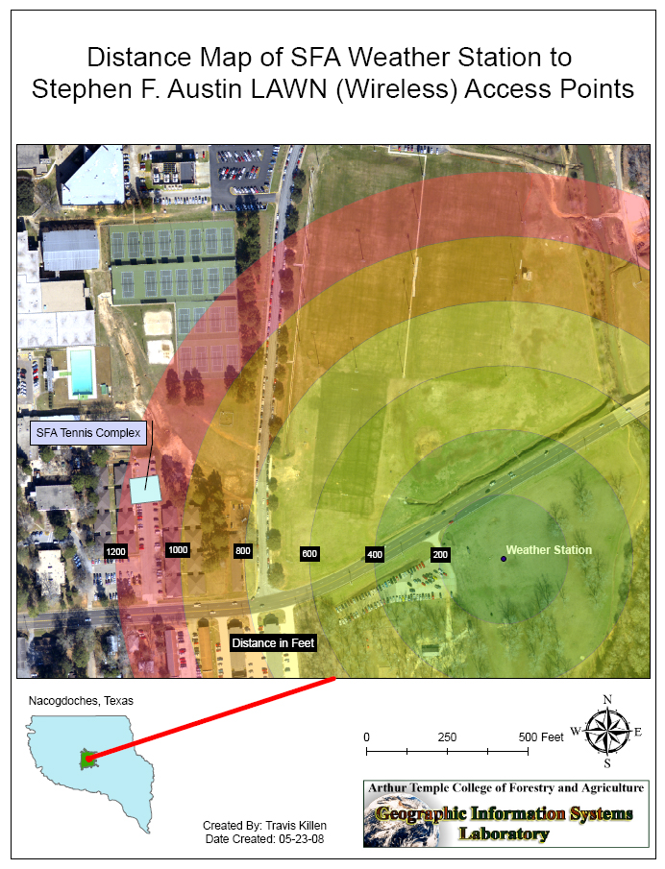
Weather Station
Maps can be used to:
Easily Compute Distances
Identify Interference
Adjust range of signal
Explore equipment options

Slide 15

Questions?
Even Einstein asked Questions

